Slide 1
Class design

Slide 2
Concepts
Composition:
Definition: "Has-a" relationship where one object contains another.
Example: A car "has-a" engine.
Advantages: Promotes loose coupling, easier to modify or replace parts.
Aggregation:
Definition: "Has-a" relationship where objects can exist independently.
Example: A department "has-a" list of employees, but employees can exist without the department
Inheritance:
Definition: "Is-a" relationship where one class derives from another.
Use sparingly to avoid tightly coupled code.

Slide 3
Code Example: Composition in Java
class Car {
private Engine engine;
public Car() {
engine = new Engine();
}
public void drive() {
engine.start();
System.out.println("Car is driving...");
}
}
class Engine {
public void start() {
System.out.println("Engine starts...");
}
}
public class Main {
public static void main(String[] args) {
Car car = new Car();
car.drive();
}
}

Slide 4
Code Example: Aggregation in Java
class Employee:
def __init__(self, name):
self.name = name
class Department:
def __init__(self, name):
self.name = name
self.employees = []
def add_employee(self, employee):
self.employees.append(employee)
def show_employees(self):
for emp in self.employees:
print(emp.name)
emp1 = Employee("Alice")
emp2 = Employee("Bob")
dept = Department("HR")
dept.add_employee(emp1)
dept.add_employee(emp2)
dept.show_employees()

Slide 5
Comparision table
Concept | Definition | Example | Key Feature
Composition | Object contains another object | Car and Engine | Tight dependency
Aggregation | Object references another | Department & Employee | Loose dependency
Inheritance | Object derives from another | Animal and Dog | Code reuse
emp1 = Employee("Alice")
emp2 = Employee("Bob")
dept = Department("HR")
dept.add_employee(emp1)
dept.add_employee(emp2)
dept.show_employees()

Slide 6
Abstract Classes vs Interfaces
Abstract Classes
Definition: A class that cannot be instantiated and may include both abstract (unimplemented) and concrete (implemented) methods.
Use Case: When classes share common functionality but also need specialized implementations.
Interfaces
Definition: A contract that specifies methods a class must implement, without providing any implementation.
Use Case: When multiple unrelated classes must adhere to the same functionality.

Slide 7
Best Practices for Designing Object Relationships
Favor Composition Over Inheritance
Avoid tight coupling by using composition unless inheritance is necessary.
Use inheritance for "is-a" relationships; prefer composition for "has-a" relationships.
Follow Interface Segregation Principle
Keep interfaces small and specific to avoid forcing classes to implement unused methods.
Encapsulate Behavior
Encapsulate varying behavior in separate classes and use delegation.
Ensure Single Responsibility
A class should have only one job or one purpose.
Use Polymorphism Appropriately
Replace conditional statements with polymorphism to enhance extensibility.

Slide 8
Class Design
You know you can implement your application with a very bad design and it will still work, but . . .

Slide 9
Class Design
You know you can implement your application with a very bad design and it will still work, but . . .
If there are bugs, the task to find and fix them will be a headache or even a nightmare.
Extensions may be also difficult to implement
Companies usually extend and release various subsequent versions of the software they release along various years, this is also difficult with a bad designed software (example: windows 3.0).

Slide 10
World of Zuul
A classic for teaching OOP
Developed at the beginning of the 70’ by Will Crowther and extended by Don Woods. Popularized by Unix distribution.
Perhaps more known as Colosal Cave Adventure(see https://en.wikipedia.org/wiki/Colossal_Cave_Adventure ).
Sophisticated and imaginative for its time, which was about founding the way through a cave finding and gathering treasures, drinking or eating things, fighting with various enemies using secret keywords
We will use it to revisit some OOP concepts

Slide 11
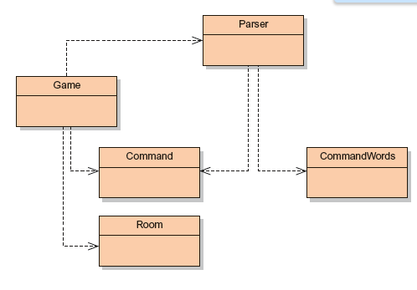
Class Diagram
Game: principal class. Initializes the game and enters a loop which reads and performs commands. It also contains the code that implements each command
Room: represent the current location. Rooms may have exits which connect to other rooms.
Command: represents a command the user entered. It has methods which allows an easy checking of its validity and obtains the first and second words of the command (like “go south”)

Slide 12
Class Diagram
Reads lines from the console and tries to interpret them as commands. Creates objects from the Command class which represent the entered command
Defines the valid commands of the game. This is done storing the strings which represent them in an array

Slide 13
Coupling & cohesion
coupling and cohesion: concepts which help to measure the quality of a design
coupling: interconnection among classes, indicates how tight are classes connected. The lower the better (loosely coupling).
In a tight coupled class structures a change in a class may trigger changes in many others.
The effect expands through the whole application is it has high coupling.
This may difficult finding the places which the code must be changed.

Slide 14
Coupling & cohesion
Cohesion relates to the number and variety of tasks a single unity is responsible inside the application.
Ideally, one unit must be responsible of a single task (a task might be seen as a logic unity).
A method must implement one logic operation, and one class must represent one type of entity.
Reason for this: re-use; if a single unity implements a well defined task then it is more probable that it will be used again in a different context.
Another plus: when doing a change for an aspect of the application, it is more probable that we find all relevant pieces in the same place.

Slide 15
Code Duplication
The code duplication is an indicator of bad design
A change in the version must be applied to all places which have the same code in order to avoid inconsistencies.
Not only increases the work of the maintenance programmer but also introduces the possibility of inserting more bugs.
The Game class presented now has examples of code duplication

Slide 16
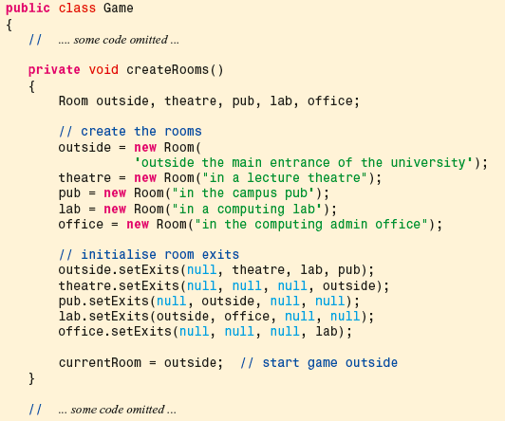
Game class

Slide 17
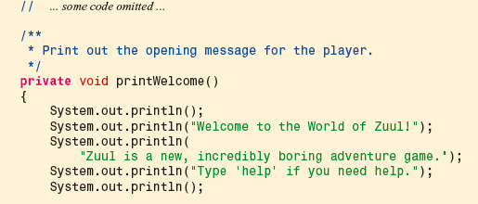
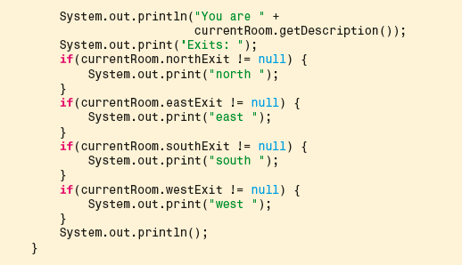
Game Class(2)

Slide 18
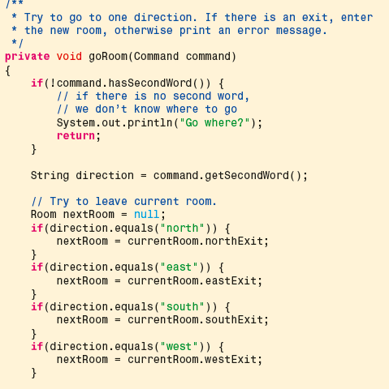
Game Class (3)

Slide 19

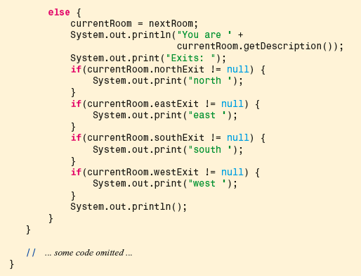
Game Class (4)

Slide 20
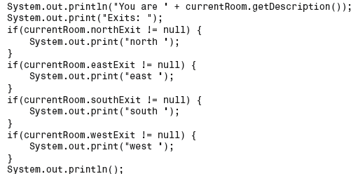
Code Duplication
Both the printWelcome and goRoom methods contain the following lines of code:
Code duplication is usually a symptom of bad cohesion:
both methods do two things: print the welcome message and prins the information about the current location.
This is a bad design .

Slide 21
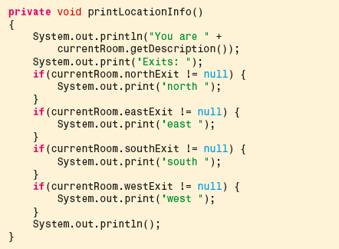
Solution
better design : use a separate method whose only task is to print the information of the current room.
both methods printWelcome and goRoom call this one

Slide 22
Coupling
Problem: Now add two more exits: up and down.
There are many places where all the existing exits are explicitly mentioned: a symptom of bad design.
Two classes are involved in this change: Room and Game..
To add two new directions, we would need to add two new exits (upExit and downExit) in these two places

Slide 23
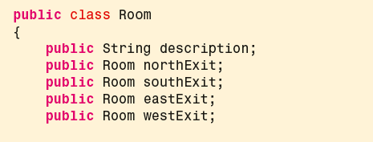
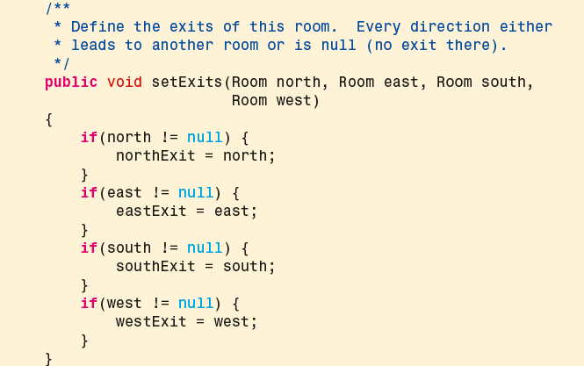
The Room class
Inside the Room class, the setExits method set the exits the room will have:

Slide 24
Solution
A more flexible design: use a HashMap table to store all the exits a room has
HashMap associate direction name (for example “north”) and the room which can be reached in that direction :
HashMap exits = new HashMap();
exits.put(“north”, aroom);
This will allow us to handle any number of exists to any direction.

Slide 25
But…
This is a change in the way a room stores information internally about neighboring rooms.
Theoretically, should affect only the implementation of the Room class (how the exit information is stored), not the interface (what the room stores).
Ideally, when implementation of a class changes, other classes should not be affected (lose coupling)
In our example, if we remove the exit variables in the Room class and replace them with a HashMap, the Game class will not compile.
There are references to the room’s exit variables ->cause errors.
Tight coupling.!!!!!!
First: decouple these classes before introducing the HashMap.

Slide 26
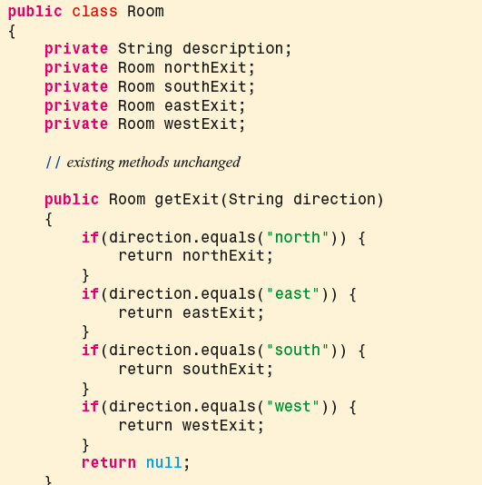
Encapsulation to reduce coupling
Separate the “what” from the “how” using a getter.
Encapsulates how the information is stored delivering the necessary information.
Advantage: we can change this without breaking the rules for the other classes.

Slide 27
Redesigning Game class
Now we need to change the Game class as well.
Wherever an exit variable was accessed, we now use the accessor method.
Instead of
nextRoom = currentRoom.eastExit;
we now can write
nextRoom = currentRoom.getExit("east");
Can be anything

Slide 28
Redesigning goRoom
Another advantage: In the goRoom method, the replacement will result in
Room nextRoom = null;
if(direction.equals("north")) {
nextRoom = currentRoom.getExit("north");
}
if(direction.equals("east")) {
nextRoom = currentRoom.getExit("east");
}
if(direction.equals("south")) {
nextRoom = currentRoom.getExit("south");
}
if(direction.equals("west")) {
nextRoom = currentRoom.getExit("west");
}
Instead, this whole code segment can now be replaced with:
Room nextRoom = currentRoom.getExit(direction);

Slide 29
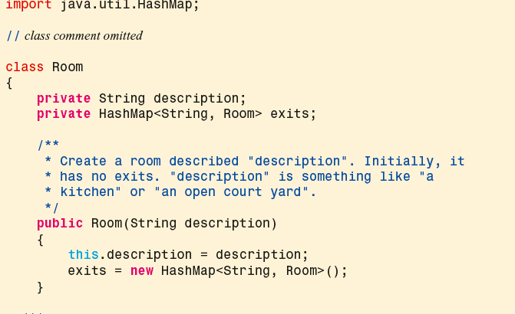
Introduce the HashMap in class Room (1)

Slide 30
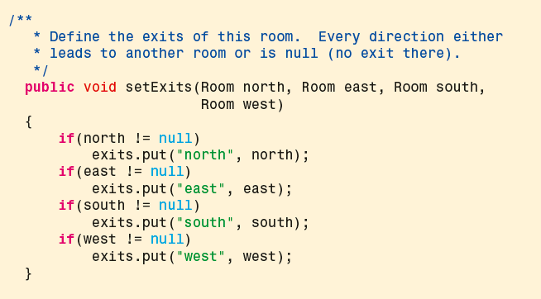
Introducing HashMap in Room (2)

Slide 31
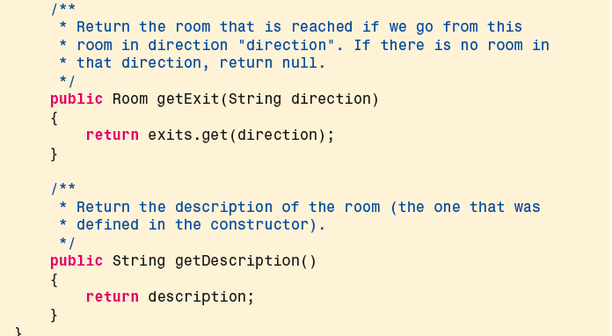
Introducing HashMap in Room (3)

Slide 32
Some thoughts
We can make this change now without even checking whether anything will break elsewhere.
We have changed only private aspects of the Room class, this change does not impact on other classes.
The interface remains unchanged.
A by-product of this change:
Room class is now shorter.
Instead of listing four separate variables, we have only one.
The getExit method is also simplified.

Slide 33
¿what happens with up and down?
We wanted to add two new possible exits in the up and down direction.
With HashMap storing exits, we can add these two additional directions will work without any change.
We can also obtain the exit information via the getExit method without any problem.
The only place where knowledge about the four existing exits (north, east, south, west) is still coded into the source is in the setExits method.
public void setExits(Room north, Room east,
Room south, Room west)
This method is part of the interface of the Room class, so any change we make to it will inevitably affect some other classes by virtue of coupling.

Slide 34
Lets change setExits
Lets change the design for a more general approach:
/**
* Define an exit from this room.
* @param direction The direction of the exit.
* @param neighbor The room in the given direction.
*/
public void setExit(String direction, Room neighbor) {
exits.put(direction, neighbor);
}
Now, instead of
lab.setExits(outside, office, null, null);
We write
lab.setExit("north", outside);
lab.setExit("east", office);
more flexible

Slide 35
Responsibility-driven design
Another way to reduce coupling
It is the process of designing classes, assigning well defined responsibilities to each class.
It is used must answer the question “which class should implement which functionality”
The answer given by Responsibility-driven design is that each class is responsible for managing its own data.
When adding functionality to an application, ask yourselve in which class should we add a method for implementing it
Question: ¿Which class should be responsible for this task?
Answer: the class who has the necessary data for doing it.

Slide 36
Responsibility and coupling
Let’s add a new room (cellar) under the office. All
we have to make small changes to the Game’s createRooms:
private void createRooms() {
Room outside, theatre, pub, lab, office, cellar;
...
cellar = new Room("in the cellar");
...
office.setExit("down", cellar);
cellar.setExit("up", office);
}
Given the new interface of the Room class, this works without problems, confirming that the new design is better.

Slide 37
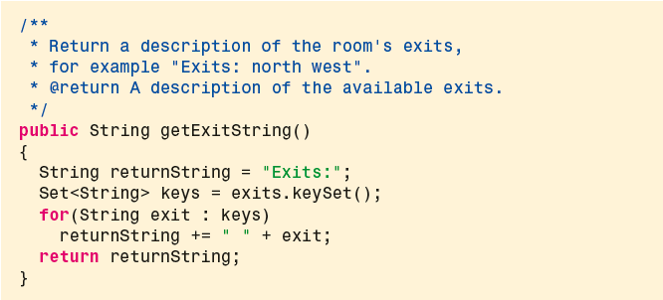
Reducing coupling
A consequence of responsibility-driven design is that the message describing the room and its exists should be prepred (provided) by the Room class itself, not by the Game class. Lets add the following method to Room

Slide 38
Reducing coupling
Currently, we have still encoded in the Game class the knowledge that the information we want from a room consists of a description string and the exit string:
System.out.println("You are " + currentRoom.getDescription());
System.out.println(currentRoom.getExitString());
What if we add items to rooms in our game? Or monsters? Or other players?
The list of items, monsters, and other players should be included in the description of the room.
We would need to make changes to the Room class to add these things, and change the code segment above where the description is printed out.
This is again a breach of the responsibility-driven design rule. Since the Room class holds information about a room,
It should also produce a description for a room (has the information)

Slide 39
Reducing coupling
We can improve this by adding to the Room class the following method:
/**
* Return a long description of this room, of the form:
* You are in the kitchen.
* Exits: north west
* @return A description of the room, including exits.
*/
public String getLongDescription() {
return "You are " + description + ".\n" + getExitString();
}
In the Game class we then write System.out.println(currentRoom.getLongDescription());
‘long description’ of a room should include the description string, information about the exits, and may in the future include anything else there is to say about a room. When we make these future extensions, we will have to make changes to only a single class: the Room class.

Slide 40
Implicit coupling
Using public fields may create unnecessarily tight form of coupling between classes -> it may be necessary to make changes to more than one class.
An even worse form of coupling: implicit coupling.
Implicit coupling is a situation where one class depends on internal information of another, but this dependence is not immediately obvious.
Tight coupling is not good, but at least it was obvious. (to change the public fields in one class, and forget about the other, may cause the application not to compile and the compiler will point out the problem)
In cases of implicit coupling, omitting a necessary change can go undetected.

Slide 41
Example of implicit coupling: introducing a look command
look prints out the description of the room and the exits again
We can introduce a new command word by adding it to the array of known words in the validCommands array in the CommandWords class:
// a constant array that holds all valid command words
private static final String validCommands[] = {"go", "quit", "help", "look"};
good cohesion: instead of defining the command words in the parser, a separate class just to define the command words is created
After making this change, when we type the command look, nothing happens.
This contrasts with the behavior of an unknown command word: if we type any unknown word, we see the reply
I don’t know what you mean...

Slide 42
Let’s introduce the look command
We can fix this by adding a method for the look command to the Game class:
private void look() {
System.out.println(currentRoom.getLongDescription());
}
After this, we only need to add a case for the look command in the processCommand method, which will invoke the look method when the look command is recognized:
if (commandWord.equals("help")) {
printHelp();
}
else if (commandWord.equals("go")) {
goRoom(command);
}
else if (commandWord.equals("look")) {
look();
}
else if (commandWord.equals("quit")) {
wantToQuit = quit(command);
}
What about the help command ?

Slide 43


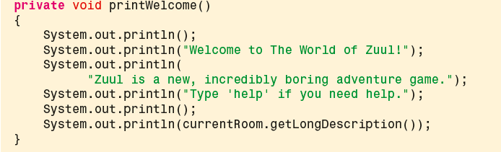
Methods cohesion
Each method responsible for one well defined task. Example:

Slide 44
Class cohesion
RULE: each class should represent one well defined entity of the problem domain
What if we introduce objects in the rooms which could be taken by the player. The player has a weight limit for carrying items.
Solution 1: include two fields in the Room class: elementDescription and elementWeight additionally in order to specify the object in each room. The description could be printed when entering the room
Low cohesion: the room class now describe the room and one object. It also suggests that an object is tied to a certain room, which is not necessarily true.
Solution 2: create a new class (Element) with fields for description and weight. A room may have a pointer to one or a list of these Elements

